Slide 1
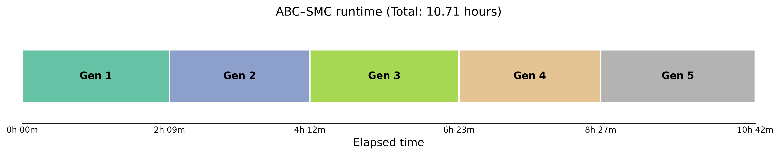
ABC_runtime
For this test, I used beta_animal and beta_wind as the parameters to estimate, running five generations with 60 accepted particles per generation.
This shows the computational time required for each generation. Each generation took more than two hours, even though no simulations were rejected.

Slide 2
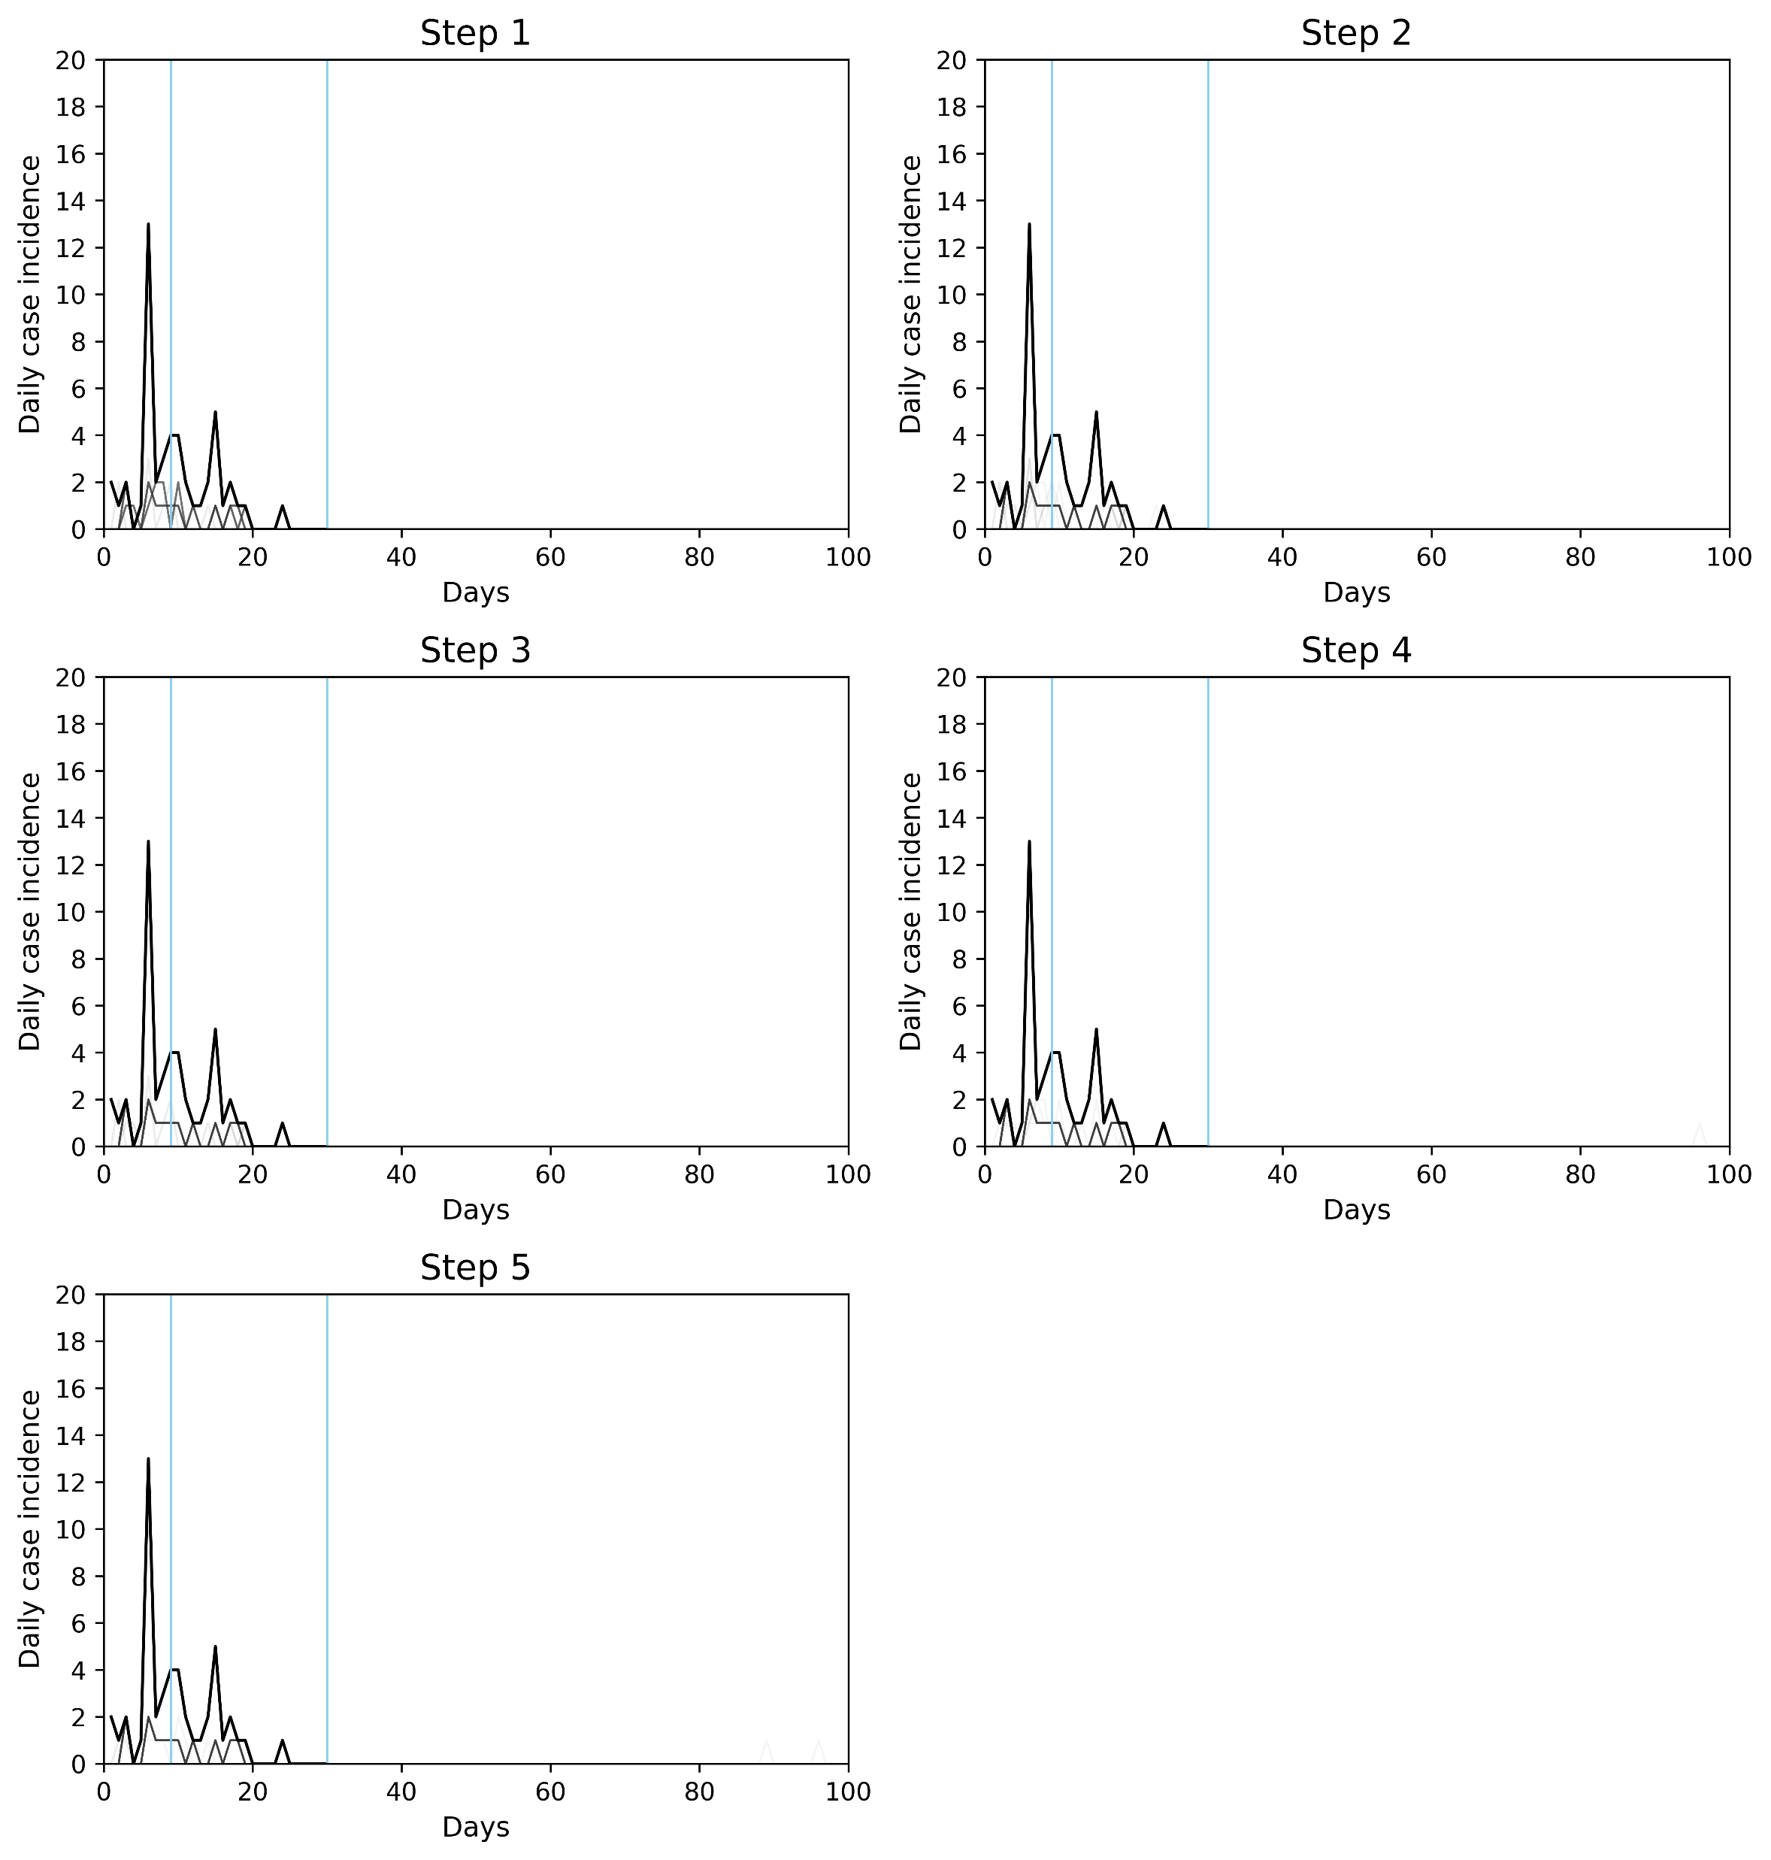
This shows how the epidemic curves converge across generations. Interestingly, there was very little variation in the epidemic curves, even across 60 different parameter sets.
While reviewing these results, I realised that the fitting window was incorrectly specified. Normally, I compared the simulations with observations from t_detect to t_today. However, since the simulations in this framework start from t_start, I think I should use t_start to t_today as the fitting window instead.
Fitting window

Slide 3
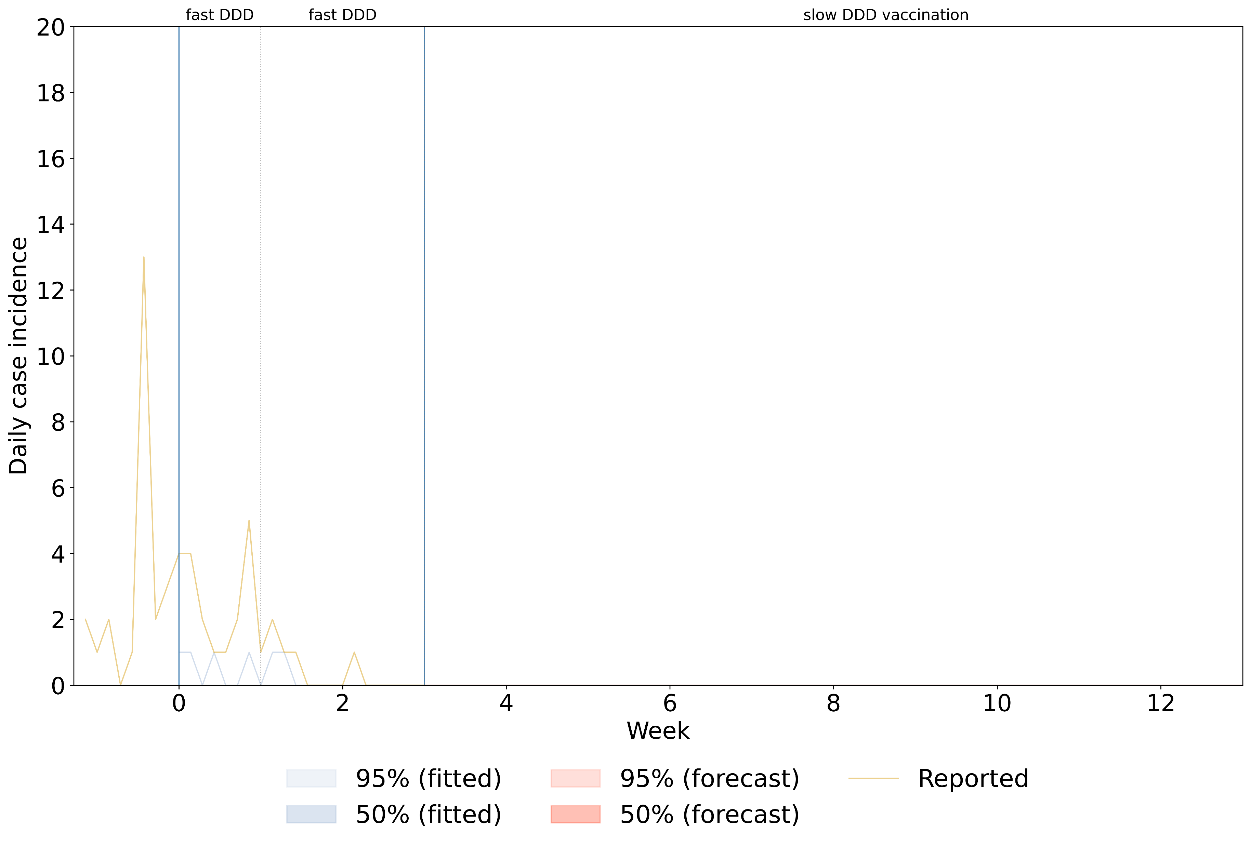
Policies up to t_today
Policy after t_today
t_today
This shows the fitted results and forecasts from the final generation, with the selected policies displayed above the figure.
As you can see, there are no visible credible intervals, because all 60 particles produced identical epidemic curves. Also, no additional farms became infected after t_today.

Slide 4
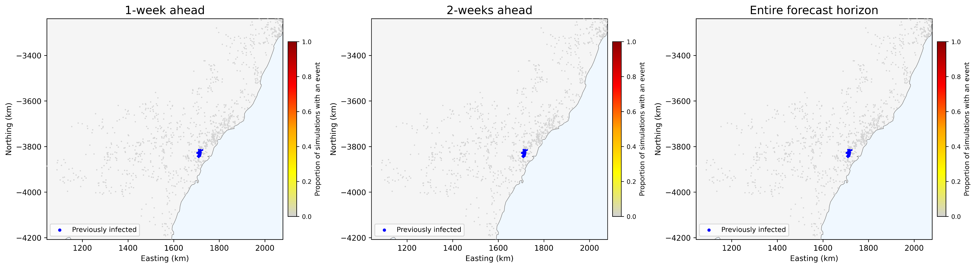
These maps show the locations of infected farms over three forecast horizons: one week, two weeks, and the entire forecast period after t_today.
However, since no new infections occurred after t_today, only the blue points representing farms infected before t_today are visible.

Slide 5
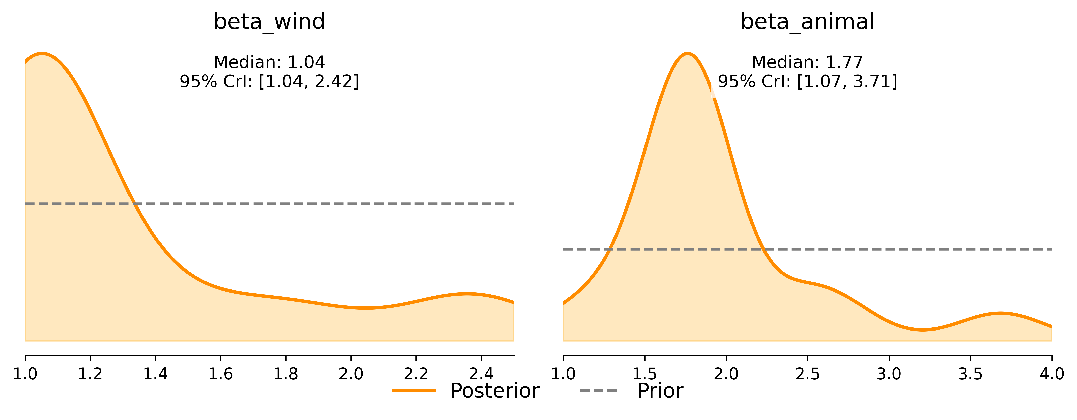
This shows the inferred posterior distributions of the parameters. The distributions appear to suggest that the algorithm is learning from the data, although I am not sure how reliable these estimates are given the unusual fitting results.
The true parameter values are 1.5 for beta_animal and 2.5 for beta_wind, respectively.

